Slide 1
CLOUD computing
By-Team sky

Slide 2
What is cloud computing ?
Cloud computing is a technology that allows users to access and store data and applications over the Internet, instead of on a local computer or server. It provides scalable, flexible, and cost-effective solutions for businesses and individuals.

Slide 3
Benefits of Cloud Computing
Scalability:
Scale up or down based on your needs, without the need for physical hardware or infrastructure changes.
Cost Efficiency:
Pay only for the resources you actually use, eliminating the need for expensive upfront investments.
Flexibility:
Access your data and applications from anywhere at any time, using any device with an internet connection.

Slide 4
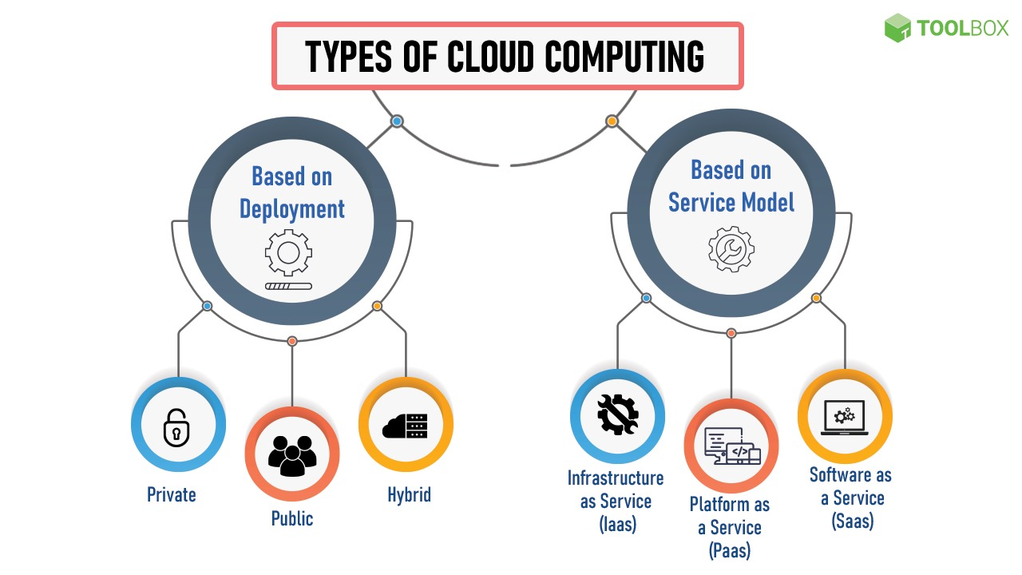

Slide 5
TYPES OF CLOUD COMPUTING SERVICES
1.Infrastructure as a Service (IaaS)
2. Software as a Services (SaaS)
3. Platform as a Service (PaaS)

Slide 6
Infrastructure as a Service (IaaS)
On-Demand Servers: Get virtual machines, storage, and network resources on-demand, without the need for physical hardware.
Elasticity: Scale your infrastructure up or down rapidly, based on your workload and performance requirements.
Security & Compliance: Ensure your data is secure with built-in security measures and comply with industry-specific regulations.Disaster RecoveryMinimize downtime and data loss with reliable backup and recovery solutions.

Slide 7
Software as a Service (SaaS)
Accessibility :Access and use cloud-based applications directly from your web browser, without the need for installation or maintenance.
Automatic Updates: Receive automatic software updates, ensuring you have the latest features and security patches.
Collaboration: Collaborate in real-time with team members, regardless of their location or device, using cloud-based collaboration tools.

Slide 8
Platform as a Service (PaaS)
Development Environment:Use pre-configured development environments to build and deploy applications quickly and easily.
Scalability & Performance:Easily scale your applications and improve performance with automatic load balancing and resource allocation.
Integrated Services:Take advantage of integrated services like databases, messaging systems, and authentication services without the need for additional configuration.

Slide 9
Types of Cloud Computing
Public Cloud: Services provided by third-party providers, accessible by multiple organizations or individuals over the internet.
Private Cloud: Cloud infrastructure owned and operated by a single organization, offering enhanced security and control.
Hybrid Cloud: A combination of public and private clouds, allowing organizations to utilize the benefits of both.

Slide 10
Cloud computing security
Data Encryption: Secure your data with encryption techniques, ensuring confidentiality and integrity.
Access Control: Implement strict access controls to prevent unauthorized access to your cloud resources.
Regular Audits: Perform regular security audits to identify vulnerabilities and address them proactively.

Slide 11
AWS
Amazon Web Services (AWS) is a comprehensive cloud computing platform offered by Amazon. It provides a wide range of on-demand services and resources for building, deploying, and managing applications and infrastructure in the cloud. With AWS, you can access virtual servers, storage, databases, AI and machine learning tools, analytics services, and much more.

Slide 12
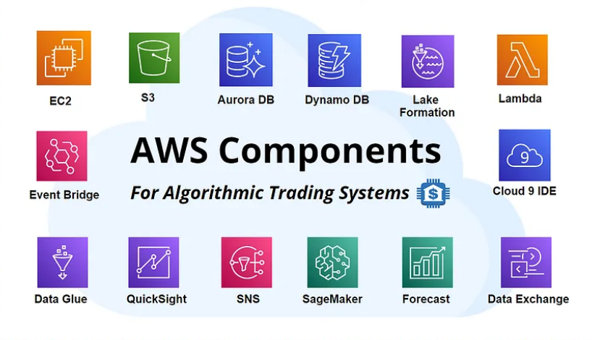
AWS components

Slide 13
Compute Services:
Amazon EC2 (Elastic Compute Cloud): Provides resizable compute capacity in the form of virtual servers (instances).
AWS Lambda: Enables serverless computing, allowing you to run code in response to events without the need to provision or manage servers.
Storage Services:
Amazon S3 (Simple Storage Service): Object storage service for scalable and secure storage of data.
Amazon EBS (Elastic Block Store): Provides persistent block-level storage volumes for use with EC2 instances.
Amazon Glacier: Low-cost storage service for data archiving and long-term backup.

Slide 14
3.Database Services:
Amazon RDS (Relational Database Service): Managed relational database service supporting multiple database engines.
Amazon DynamoDB: Fully managed NoSQL database service.
Amazon Redshift: Fully managed data warehouse service for analytics.
4.Networking:
Amazon VPC (Virtual Private Cloud): Allows users to provision a logically isolated section of the AWS Cloud.
Amazon Route 53: Scalable domain name system (DNS) web service.
Elastic Load Balancing (ELB): Distributes incoming application traffic across multiple EC2 instances.
5.Security and Identity:
AWS Identity and Access Management (IAM): Manages access to AWS services and resources securely.
AWS Key Management Service (KMS): Centralized key management service for creating and controlling encryption keys.
Amazon GuardDuty: Managed threat detection service that continuously monitors for malicious activity.

Slide 15
6.Machine Learning and AI:
Amazon Sage Maker: Fully managed service for building, training, and deploying machine learning models.
Amazon Polly: Text-to-speech service.
Amazon Recognition: Image and video analysis service.
7.Analytics:
Amazon Athena: Query service that enables analysis of data in Amazon S3 using standard SQL.
Amazon Redshift: Data warehouse service for analytics.
Amazon EMR (Elastic MapReduce): Cloud-based big data platform.
8.Developer Tools:
AWS CodeCommit: Version control service.
AWS CodeBuild: Fully managed build service.
AWS CodeDeploy: Automates code deployments to any instance, including EC2 instances and Lambda functions.

Slide 16
Aws EC2
Amazon Elastic Compute Cloud (Amazon EC2) is a web service provided by Amazon Web Services (AWS) that enables users to run virtual servers, commonly referred to as instances, in the cloud. EC2 instances can be used for various computing purposes, such as hosting websites, running applications, and performing data processing tasks. Here's a brief understanding of EC2 and its key components:

Slide 17
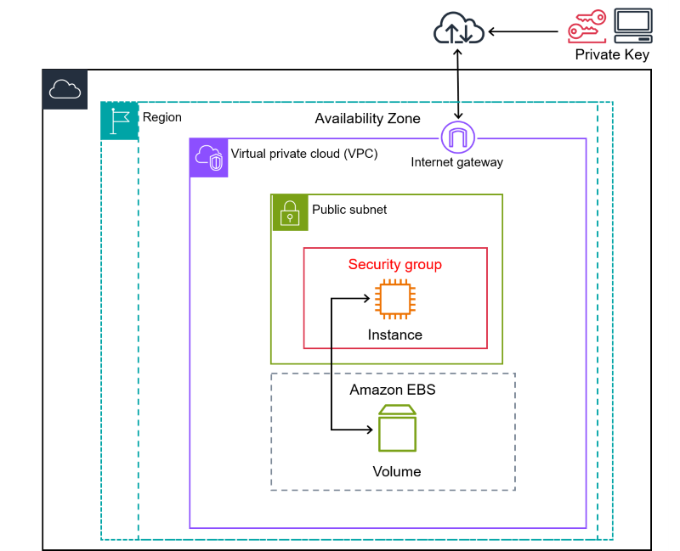

Slide 18
COMPONENTS OF EC2
Amazon Machine Image (AMI): An AMI is a template that contains a configuration for an instance. It includes the operating system, applications, and settings that will be used when the instance is launched.
Instance types: EC2 offers a variety of instance types, each with its own CPU, memory, and storage configuration. Users can choose the instance type that best suits their needs.
Elastic Block Store (EBS): EBS is a durable, block-level storage service that can be used to store data for EC2 instances. Simple Storage Service (S3): S3 is an object storage service that can be used to store data for long-term archival.
Virtual Private Cloud (VPC): A VPC is a private network that can be used to isolate an instance from the public internet.
Security groups: Security groups are used to control inbound and outbound traffic to instances.
Load balancers: Load balancers are used to distribute traffic across multiple instances.
Auto Scaling: Auto Scaling is used to automatically scale the number of instances up or down based on demand.
CloudWatch: CloudWatch is used to monitor the performance and health of EC2 instances.

Slide 19
THANK YOU

